Slide 1
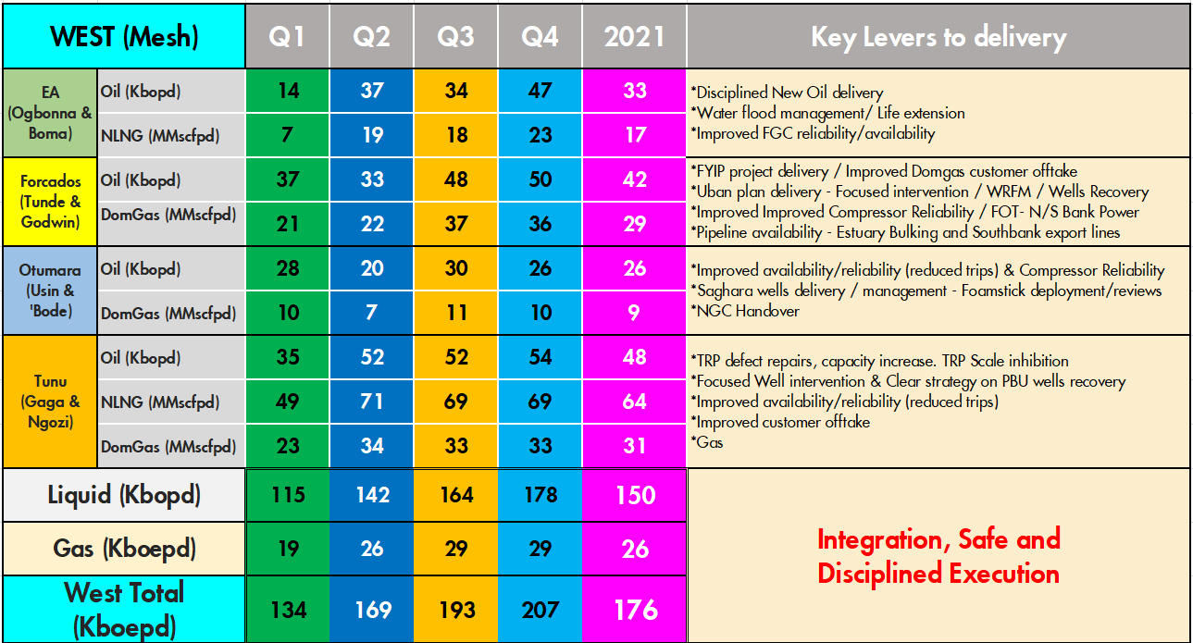
West 2021 Outlook & Key Delivery Levers (176Kboepd)
Accountability
Ownership
AMS, CI, Digitalization & People

Slide 2
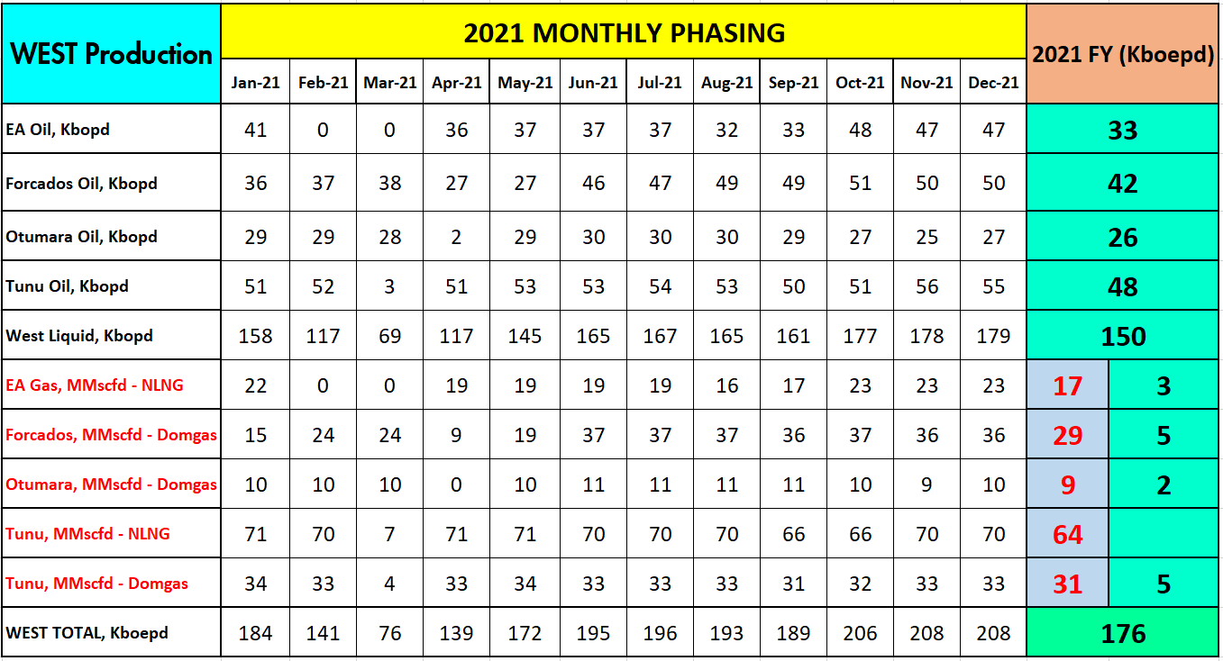
West 2021 Monthly Phasing (176Kboepd)
West is Oil
Busari
AMS, CI, Digitalization & People
Oil is Cash

